Slide 1

Fundamental Big Data Analytics & Science

Slide 2
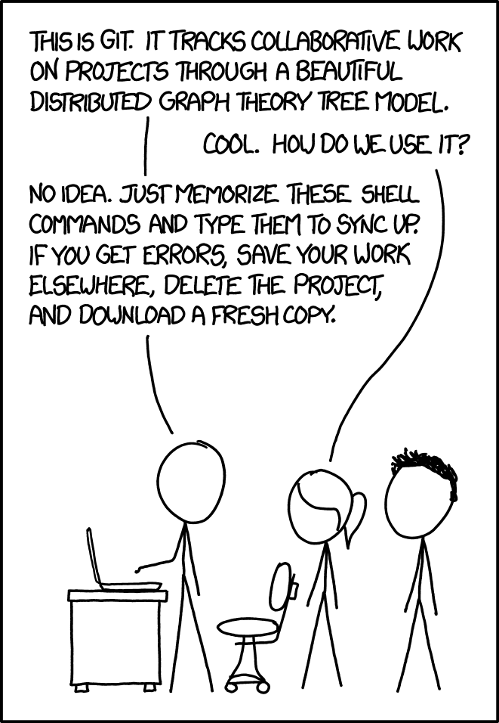
What is Git

Slide 3
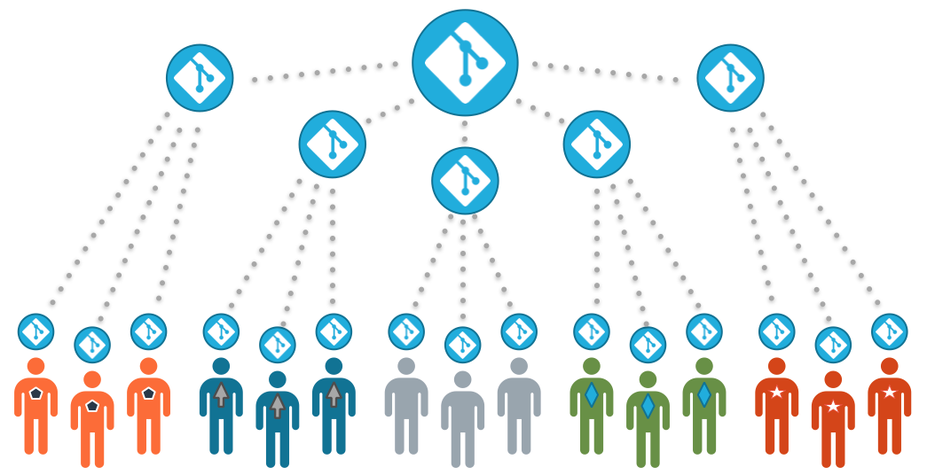

Slide 4
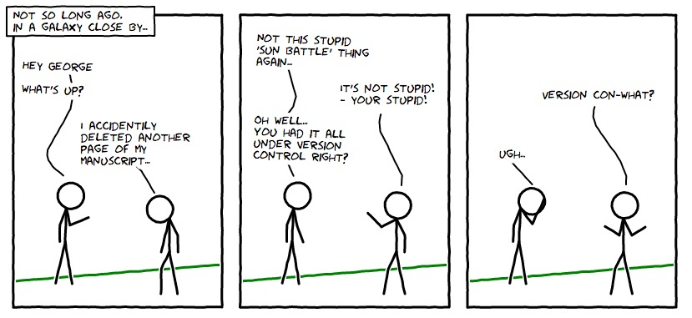
Why use Git?

Slide 5

What is GitHub

